Slide 1
HTML 5 AND CSS BASICS
by Oksana Rudka

Slide 2
AGENDA
What is HTML?
HTML Head
HTML Links
HTML Images
HTML Tables
HTML Forms
HTML5 Semantic Elements
What is CSS?
CSS Selectors
CSS Pseudo-classes
CSS Pseudo-elements
CSS Specificity
CSS Size Calculation
Margin Collapse
CSS Position

Slide 3
WHAT IS HTML?

Slide 4
INTRODUCTION
HTML is the standard markup language for creating Web pages.
HTML stands for Hyper Text Markup Language
HTML describes the structure of Web pages using markup
HTML elements are the building blocks of HTML pages
HTML elements are represented by tags
HTML tags label pieces of content such as "heading", "paragraph", "table", and so on
Browsers do not display the HTML tags, but use them to render the content of the page

Slide 5
A SIMPLE HTML DOCUMENT
<!DOCTYPE html> <html> <head> <title>Page Title</title> </head> <body> <h1>My First Heading</h1> <p>My first paragraph.</p> </body> </html>

Slide 6
HTML TAGS
HTML tags are element names surrounded by angle brackets:
<tagname>…content goes here</tagname>
HTML tags normally comes in pairs like <p> and </p>
The first tag in a pair is the start tag, the second tag is the end tag
The end tag is written like the start tag, but with a forward slash inserted before the tag name

Slide 7
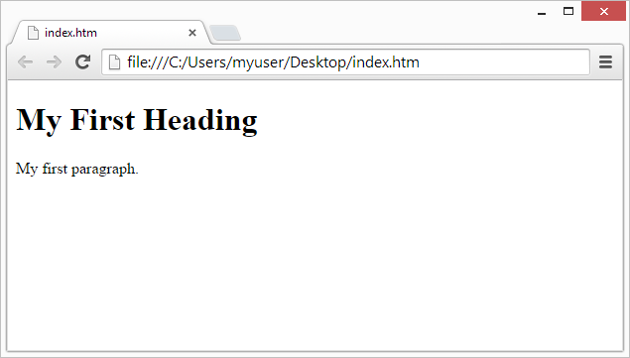
WEB BROWSERS
The purpose of a web browser (Chrome, IE, Firefox, Safari) is to read HTML documents and display them.
The browser does not display the HTML tags, but uses them to determine how to display the document:

Slide 8
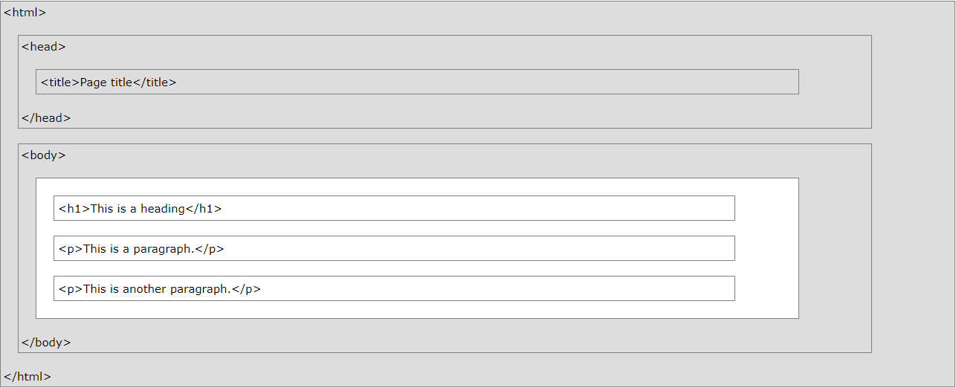
HTML PAGE STRUCTURE
Below is a visualization of an HTML page structure:

Slide 9
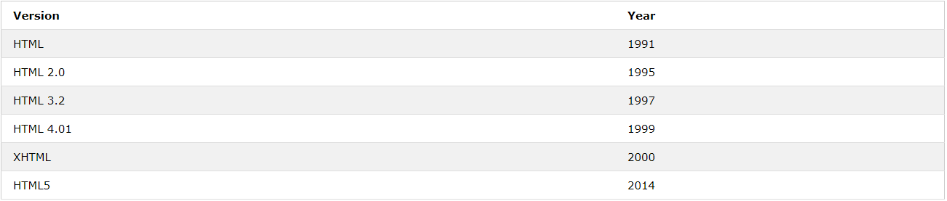
HTML VERSIONS
Since the early days of the web, there have been many versions of HTML:

Slide 10
HTML HEAD

Slide 11
THE HTML <HEAD> ELEMENT
The <head> element is a container for metadata (data about data) and is placed between the <html> tag and the <body> tag.
HTML metadata is data about the HTML document.
Metadata is not displayed. Metadata typically define the document title, character set, styles, links, scripts, and other meta information.
The following tags describe metadata: <title>, <style>, <meta>, <link>, <script> and <base>.

Slide 12
HTML HEAD ELEMENTS
TAG | DESCRIPTION
<head> | Defines information about the document
<title> | Defines the title of a document
<base> | Defines a default address or a default target for all links on a page
<link> | Defines the relationship between a document and an external resource
<meta> | Defines metadata about an HTML document
<script> | Defines a client-side script
<style> | Defines style information for a document

Slide 13
HTML LINKS

Slide 14
HTML LINKS - HYPERLINKS
HTML links are hyperlinks.
You can click on a link and jump to another document.
When you move the mouse over a link, the mouse arrow will turn into a little hand.
NOTE: A link does not have to be text. It can be an image or any other HTML element.

Slide 15

HTML LINKS - SYNTAX
In HTML, links are defined with the <a> tag:
<a href="url">link text</a>
EXAMPLE:
<a href="https://www.w3schools.com/html/">HTML tutorial</a>
The href attribute specifies the destination address (https://www.w3schools.com/html/) of the link.
The link text is the visible part (Visit our HTML tutorial). Clicking on the link text will send you to the specified address.

Slide 16
HTML LINKS COLORS
<style> a:link { color: green; background-color: transparent; text-decoration: none; } a:visited { color: pink; background-color: transparent; text-decoration: none; } a:hover { color: red; background-color: transparent; text-decoration: underline; } a:active { color: yellow; background-color: transparent; text-decoration: underline; } </style>
By default, a link will appear like this (in all browsers):
An unvisited link is underlined and blue
A visited link is underlined and purple
An active link is underlined and red
You can change the default colors, by using CSS:

Slide 17
HTML LINKS – THE TARGET ATTRIBUTE
The target attribute specifies where to open the linked document.
The target attribute can have one of the following values:
_blank - Opens the linked document in a new window or tab
_self - Opens the linked document in the same window/tab as it was clicked (this is default)
_parent - Opens the linked document in the parent frame
_top - Opens the linked document in the full body of the window
framename - Opens the linked document in a named frame

Slide 18
CHAPTER SUMMARY
Use the <a> element to define a link
Use the href attribute to define the link address
Use the target attribute to define where to open the linked document
Use the <img> element (inside <a>) to use an image as a link
Use the id attribute (id="value") to define bookmarks in a page
Use the href attribute (href="#value") to link to the bookmark

Slide 19
HTML IMAGES

Slide 20
HTML IMAGES SYNTAX
In HTML, images are defined with the <img> tag.
The <img> tag is empty, it contains attributes only, and does not have a closing tag.
The src attributee specifies the URL (web address) of the image:
<img src="url">

Slide 21
HTML IMAGES SYNTAX
THE ALT ATTRIBIMUTE
The alt attribute provides an alternate text for an image, if the user for some reason cannot view it (because of slow connection, an error in the src attribute, or if the user uses a screen reader). The value of the alt attribute should describe the image:
<img src="img_chania.jpg" alt="Flowers in Chania">
IMAGE SIZE - WIDTH AND HEIGHT
You can use the width and height attributes:
<img src="img_girl.jpg" alt="Girl in a jacket" width="500" height="600">

Slide 22
HTML IMAGES SYNTAX
Use the HTML <img> element to define an image
Use the HTML src attribute to define the URL of the image
Use the HTML alt attribute to define an alternate text for an image, if it cannot be displayed
Use the HTML width and height attributes to define the size of the image
Use the CSS width and height properties to define the size of the image (alternatively)
Use the CSS float property to let the image float
Use the HTML <map> element to define an image-map (Demo)
Use the HTML <area> element to define the clickable areas in the image-map
Use the HTML <img>'s element usemap attribute to point to an image-map
Use the HTML <picture> element to show different images for different devices

Slide 23
HTML TABLES

Slide 24
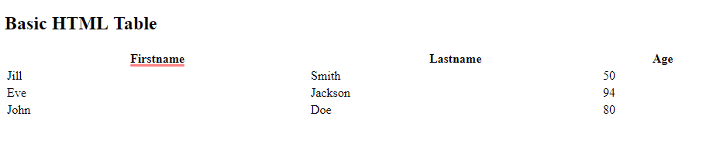
DEFINING AN HTML TABLE
An HTML table is defined with the <table> tag. Each table row is defined with the <tr> tag. A table header is defined with the <th> tag. By default, table headings are bold and centered. A table data/cell is defined with the <td> tag.
<table style="width:100%"> <tr> <th>Firstname</th> <th>Lastname</th> <th>Age</th> </tr> <tr> <td>Jill</td> <td>Smith</td> <td>50</td> </tr> <tr> <td>Eve</td> <td>Jackson</td> <td>94</td> </tr> </table>

Slide 25
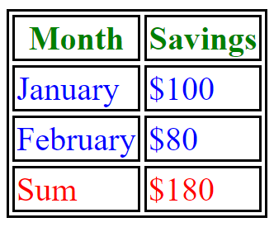
DEFINING AN HTML TABLE
An HTML table with a <thead>, <tbody>, and a <tfoot> element:
<table> <thead>
<tr> <th>Month</th> <th>Saving</th> </tr> </thead>
<tbody>
<tr> <th>January</th> <th>$100</th> </tr>
</tbody>
<tbody>
<tr> <th>Fabruary</th> <th>$80</th> </tr>
</tbody>
</table>

Slide 26
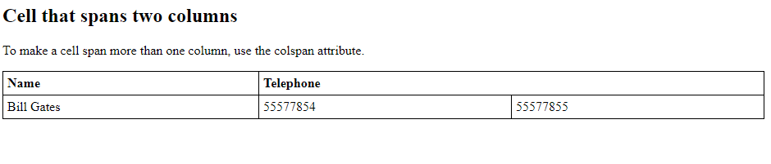
HTML TABLE - CELLS THAT SPAN MANY COLUMNS
To make a cell span more than one column, use the colspan attribute:
<table style="width:100%"> <tr> <th>Name</th> <th colspan="2">Telephone</th> </tr> <tr> <td>Bill Gates</td> <td>55577854</td> <td>55577855</td> </tr> </table>

Slide 27
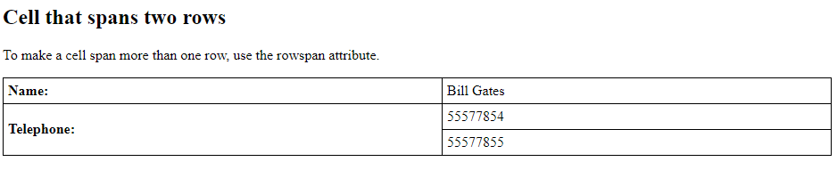
HTML TABLE - CELLS THAT SPAN MANY ROWS
To make a cell span more than one row, use the rowspan attribute:
<table style="width:100%"> <tr> <th>Name:</th> <td>Bill Gates</td> </tr> <tr> <th rowspan="2">Telephone:</th> <td>55577854</td> </tr> <tr> <td>55577855</td> </tr> </table>

Slide 28
TABLE SUMMARY
Use the HTML <table> element to define a table
Use the HTML <tr>, <td>, <th> element to define a table row, data, heading
Use the HTML <caption> element to define a table caption
Use the CSS border property to define a border
Use the CSS border-collapse property to collapse cell borders
Use the CSS padding property to add padding to cells
Use the CSS text-align property to align cell text
Use the CSS border-spacing property to set the spacing between cells
Use the colspan attribute to make a cell span many columns
Use the rowspan attribute to make a cell span many rows

Slide 29
HTML FORMS

Slide 30
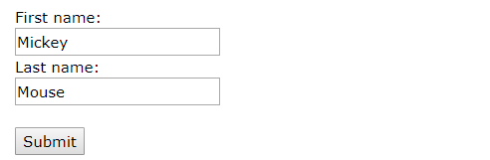
THE <FORM> ELEMENT
The HTML <form> element defines a form that is used to collect user input:
<form> . form elements . </form>
An HTML form contains form elements.
Form elements are different types of input elements, like text fields, checkboxes, radio buttons, submit buttons, and more.

Slide 31
THE <INPUT> ELEMENT
The <input> element is the most important form element.
The <input> element can be displayed in several ways, depending on the type attribute.
Here are some examples:
TYPE | DESCRIPTION
<input type="text"> | Defines a one-line text input field
<input type="radio"> | Defines a radio button (for selecting one of many choices)
<input type="submit"> | Defines a submit button (for submitting the form)

Slide 32
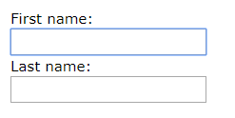

THE <INPUT> ELEMENT
<form> First name:<br> <input type="text" name="firstname"><br> Last name:<br> <input type="text" name="lastname"> </form>
<form> <input type="radio" name="gender"
value="male" checked> Male<br> <input type="radio" name="gender"
value="female"> Female<br> <input type="radio" name="gender"
value="other"> Other </form>

Slide 33
THE FORM ATTRIBUTES
THE TARGET ATTRIBUTE
The target attribute specifies if the submitted result will open in a new browser tab, a frame, or in the current window.
The default value is "_self" which means the form will be submitted in the current window. To make the form result open in a new browser tab, use the value "_blank":
<form action="/action_page.php" target="_blank">

Slide 34
THE FORM ATTRIBUTES
THE METHOD ATTRIBUTE
The method attribute specifies the HTTP method (GET or POST) to be used when submitting the form data:
<form action="/action_page.php" method="get">
<form action="/action_page.php" method="post">

Slide 35
THE FORM ATTRIBUTES
THE NAME ATTRIBUTE
Each input field must have a name attribute to be submitted.
If the name attribute is omitted, the data of that input field will not be sent at all.
<form action="/action_page.php"> First name:<br> <input type="text" value="Mickey"><br> Last name:<br> <input type="text" name="lastname" value="Mouse"><br><br> <input type="submit" value="Submit"> </form>

Slide 36
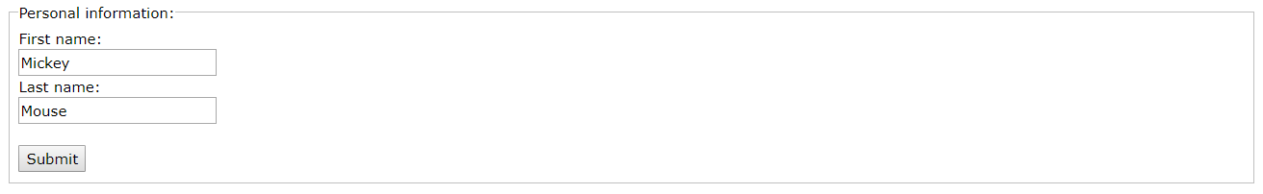
GROUPING FORM DATA WITH <FIELDSET>
The <fieldset> element is used to group related data in a form.
The <legend> element defines a caption for the <fieldset> element.
<form action="/action_page.php"> <fieldset> <legend>Personal information:</legend> First name:<br> <input type="text" name="firstname" value="Mickey"><br> Last name:<br> <input type="text" name="lastname" value="Mouse"><br><br> <input type="submit" value="Submit"> </fieldset> </form>

Slide 37
ALL <FORM> ATTRIBUTES
ATTRIBUTE | DESCRIPTION
accept-charset | Specifies the charset used in the submitted form (default: the page charset).
action | Specifies an address (url) where to submit the form (default: the submitting page).
autocomplete | Specifies if the browser should autocomplete the form (default: on).
enctype | Specifies the encoding of the submitted data (default: is url-encoded).
method | Specifies the HTTP method used when submitting the form (default: GET).
name | Specifies a name used to identify the form (for DOM usage: document.forms.name).
novalidate | Specifies that the browser should not validate the form.
target | Specifies the target of the address in the action attribute (default: _self).

Slide 38
DEMO
HTML Form Elements
HTML Input Types
HTML Input Attributes

Slide 39
HTML 5 SEMANTIC ELEMENTS

Slide 40
HTML 5 SEMANTIC ELEMENTS
Semantics is the study of the meanings of words and phrases in a language.
Semantic elements = elements with a meaning.
Examples of non-semantic elements: <div> and <span> - Tells nothing about its content.
Examples of semantic elements: <form>, <table>, and <article> - Clearly defines its content.

Slide 41
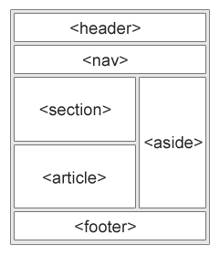
HTML 5 SEMANTIC ELEMENTS
HTML5 offers new semantic elements to define different parts of a web page:
<article>
<aside>
<details>
<figcaption>
<figure>
<footer>
<header>
<main>
<mark>
<nav>
<section>
<summary>
<time>
DEMO

Slide 42
CSS INTRODUCTION

Slide 43
CSS INTRODUCTION
What is CSS?
CSS stands for Cascading Style Sheets
CSS describes how HTML elements are to be displayed on screen, paper, or in other media
CSS saves a lot of work. It can control the layout of multiple web pages all at once
External stylesheets are stored in CSS files

Slide 44
CSS SELECTORS AND COMBINATORS
In CSS, selectors are patterns used to select the element(s) you want to style.
Selector | Example | Example description
.class | .intro | Selects all elements with class="intro"
#id | #firstname | Selects the element with id="firstname"
* | * | Selects all elements
element | p | Selects all <p> elements
element,element | div, p | Selects all <div> elements and all <p> elements
element element | div p | Selects all <p> elements inside <div> elements
element>element | div > p | Selects all <p> elements where the parent is a <div> element
element+element | div + p | Selects all <p> elements that are placed immediately after <div> elements
element1~element2 | p ~ ul | Selects every <ul> element that are preceded by a <p> element
[attribute] | [target] | Selects all elements with a target attribute
[attribute=value] | [target=_blank] | Selects all elements with target="_blank"

Slide 45
CSS PSEUDO-CLASSES
A pseudo-class is used to define a special state of an element.
For example, it can be used to:
Style an element when a user mouses over it
Style visited and unvisited links differently
Style an element when it gets focus
selector:pseudo-class { property:value; }
CSS PSEUDO CLASSES

Slide 46
CSS PSEUDO-ELEMENTS
A CSS pseudo-element is used to style specified parts of an element.
For example, it can be used to:
Style the first letter, or line, of an element
Insert content before, or after, the content of an element
selector::pseudo-element { property:value; }
CSS PSEUDO ELEMETNS

Slide 47
CSS SPECIFICITY
If there are two or more conflicting CSS rules that point to the same element, the browser follows some rules to determine which one is most specific and therefore wins out.
Think of specificity as a score/rank that determines which style declarations are ultimately applied to an element.
The universal selector (*) has low specificity, while ID selectors are
highly specific!

Slide 48
CSS SPECIFICITY
Specificity Hierarchy
Every selector has its place in the specificity hierarchy. There are four categories which define the specificity level of a selector:
Inline styles - An inline style is attached directly to the element to be styled. Example: <h1 style="color: #ffffff;">.
IDs - An ID is a unique identifier for the page elements, such as #navbar.
Classes, attributes and pseudo-classes - This category includes .classes, [attributes] and pseudo-classes such as :hover, :focus etc.
Elements and pseudo-elements - This category includes element names and pseudo-elements, such as h1, div, :before and :after.

Slide 49
CSS SPECIFICITY
How to calculate specificity?
Start at 0, add 1000 for style attribute, add 100 for each ID, add 10 for each attribute,
class or pseudo-class, add 1 for each element name or pseudo-element.
Consider these three code fragments:
A: h1 B: #content h1 C: <div id="content"><h1 style="color: #ffffff">Heading</h1></div>
The specificity of A is 1 (one element) The specificity of B is 101 (one ID reference and one element) The specificity of C is 1000 (inline styling)
Since 1 < 101 < 1000, the third rule (C) has a greater level of specificity, and therefore will be applied.

Slide 50
CSS SIZE CALCULATION

Slide 51
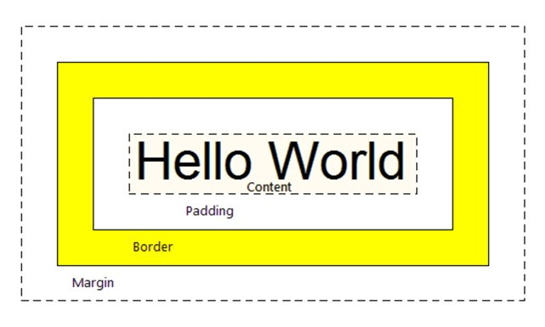
CSS BOX SIZING
By default, the width and height of an element is calculated like this:
width + padding + border = actual width of an element height + padding + border = actual height of an element
This means: When you set the width/height of an element, the element often appear bigger than you have set (because the element's border and padding are added to the element's specified width/height).
EXAMPLE

Slide 52
MARGIN COLLAPSE

Slide 53
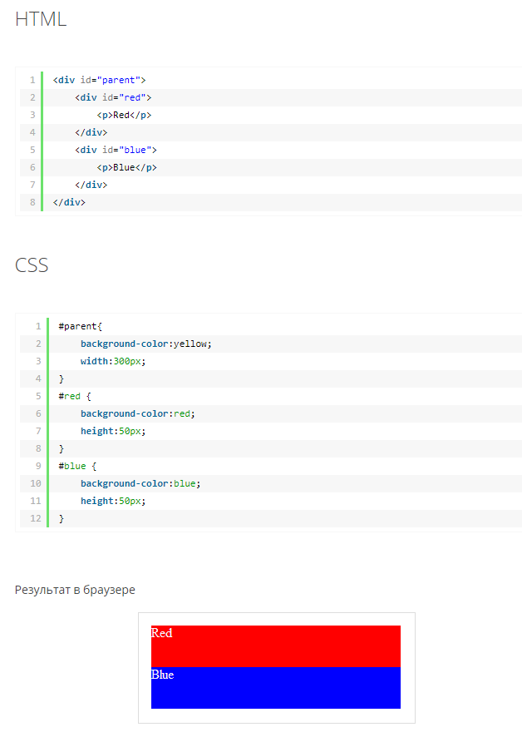
CSS BOX SIZING
Top and bottom margins of elements are sometimes collapsed into a single margin that is equal to the largest of the two margins.
This does not happen on left and right margins! Only top and bottom margins!

Slide 54
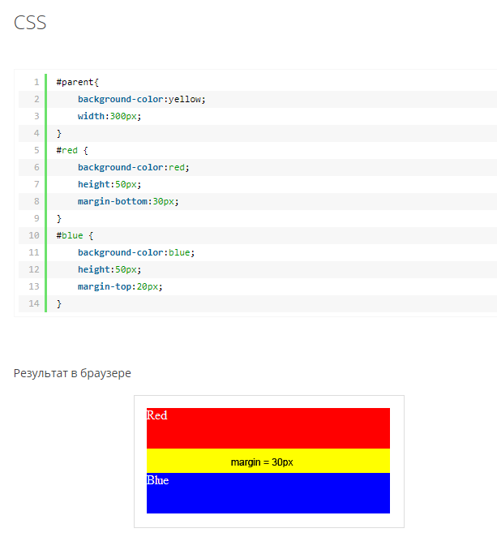
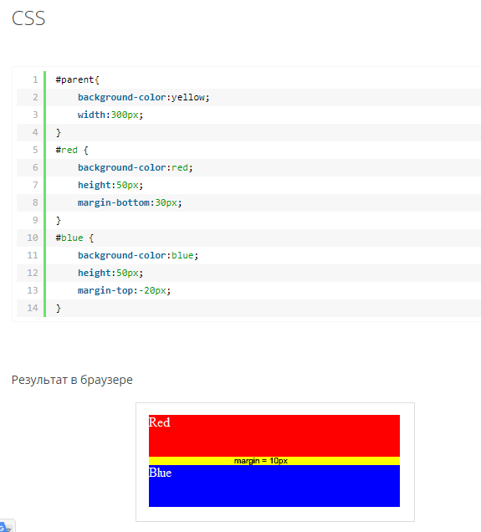
CSS BOX SIZING

Slide 55
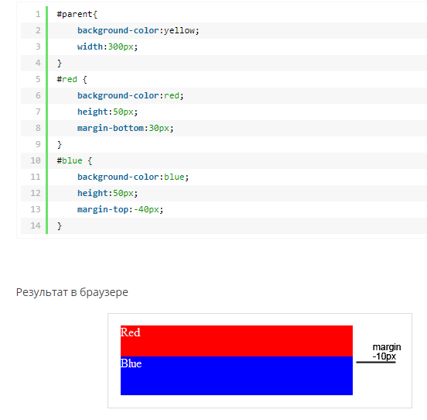
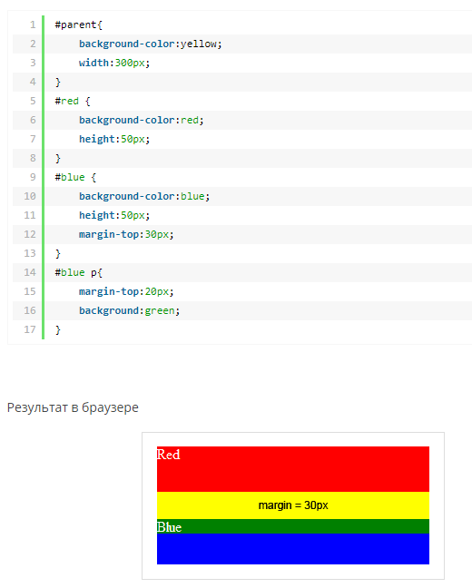
CSS BOX SIZING

Slide 56
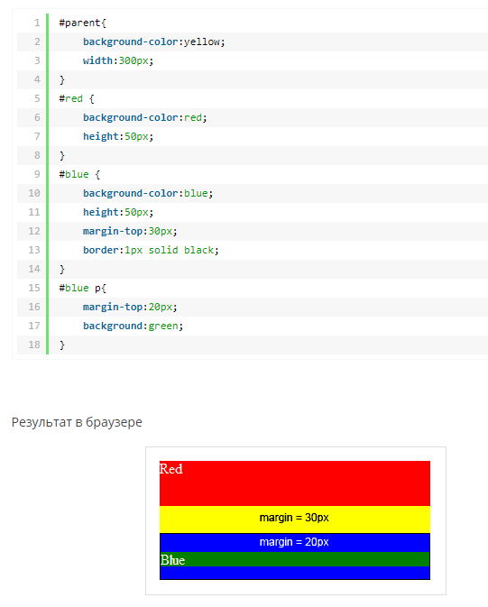
CSS BOX SIZING
Add boarder or padding.

Slide 57
CSS POSITION

Slide 58
THE DISPLAY PROPERTY
The display property specifies if/how an element is displayed. Every HTML element has a default display value depending on what type of element it is. The default display value for most elements is block or inline.
A block-level element always starts on a new line and takes up the full width available (stretches out to the left and right as far as it can).
An inline element does not start on a new line and only takes up as much width as necessary.
EXAMPLES OF BLOCK-LEVEL ELEMENTS:
<div>
<h1> - <h6>
<p>
<form>
<header>
<footer>
<section>
EXAMPLES OF INLINE ELEMENTS:
<span>
<a>
<img>

Slide 59
CSS POSITION
The position property specifies the type of positioning method used for an element.
There are five different position values:
static
relative
fixed
absolute
sticky
Elements are then positioned using the top, bottom, left, and right properties. However, these properties will not work unless the position property is set first. They also work differently depending on the position value.

Slide 60
CSS Z-INDEX
Overlapping Elements
When elements are positioned, they can overlap other elements.
The z-index property specifies the stack order of an element (which element should be placed in front of, or behind, the others).
An element can have a positive or negative stack order.

Slide 61
QUESTIONS ?

Slide 62
USED MATERIALS
https://www.w3schools.com/https://techbeacon.com/infrastructure-code-engine-heart-devops
https://www.w3schools.com/html/default.asp
https://www.w3schools.com/css/default.asp
https://learn.javascript.ru/css-for-js
https://www.sitepoint.com/collapsing-margins/
https://css-tricks.com/

Slide 63
USEFUL LINKS
https://css-tricks.com/all-about-floats/
https://css-tricks.com/snippets/css/a-guide-to-flexbox/
https://css-tricks.com/snippets/css/complete-guide-grid/
https://aerolab.co/blog/flexbox-grids/

Slide 64
THANK YOU

